Slide 1

Project for Wireless Mesh network channel assignment
CSE 812
Xiaoyan Li, Zhongzheng Chen, Chang Liu

Slide 2

Wireless Mesh network-multi-channel-unicast

Slide 3

Mesh network problems
Network performance metric
Link optimization
Interference problem
Mesh network optimization
Load topology
Routing approaches
Static or dynamic

Slide 4

Mesh Network optimization
Internet

Slide 5
Is minimizing inference the same as maximizing traffic?
Internet
Channel B
Channel A
Channel C
Channel A
Channel C
Link removal also results in graph partition, channel assignment and routing approach problems
Hassen A, Mohamed O, Shamala S, Nor A, 2016

Slide 6
Link optimization methods
Spanning tree link optimization
Raniwala and Chiueh, 2005; Kim and Suh, 2010
Traffic profile link optimization
Skalli et al., 2007; Subramanian et al., 2008
Flow-based link optimization
Chiu et al., 2009; Mogaibel et al., 2012
Power control link optimization
Chaudhry et al., 2012
High quality metric link optimization
Draves et al. 2004

Slide 7
Interference
Channel 1
Channel 1
Node A
Node B
Node C
Channel 1
Intra-flow interference
Node A
Node B
Channel 1
Node C
Channel 1
Channel 1
Node C
Node D
Hidden node inference
Inter-flow inference
Node A
Node B
Node D
External source
External source inference
Rate inference
High rate Channel 1
Channel 1
Channel 1
Node A
Node B
Low rate Channel 1
Node C
Node D
Node C
Node D

Slide 8
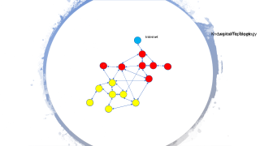
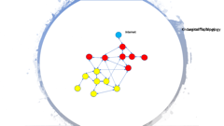
Load topology
Logic topology
Interference
Traffic topology
Routing strategy

Slide 9

Known traffic Topology
Logical Topology
Internet
Internet

Slide 10
Static or Dynamic
Load
Dynamic or static
Dynamic load
Static load
Logic graph
Static solution
Logic graph dynamic
Logic graph static
routing
routing
Routing dynamic
Routing static
Routing dynamic
Routing static

Slide 11
Static or Dynamic
Static
Dynamic
Flow response
Easy to implement
Flexible
No response time
Response time
Stable
Optimize capacity

Slide 12
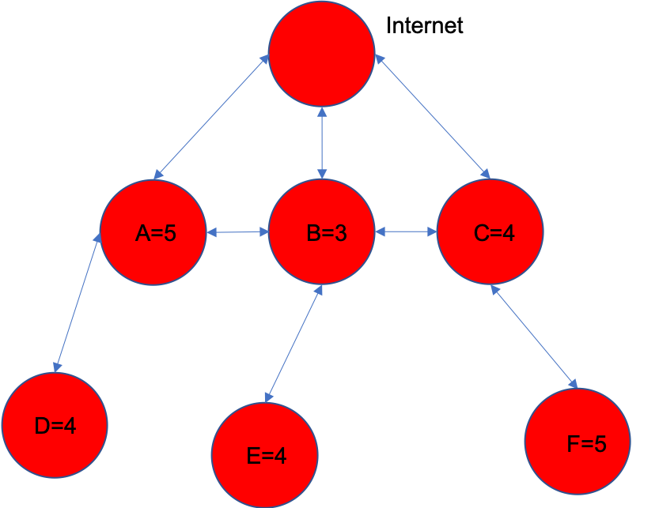
What is the good measure?
Channel 1
Node A
Node B
Min interference
High flow median
High network capacity
High total flow
Channel 1
Node C
Node D
Internet
A
B
C
Internet
A
B
C
F = 5
F = 4
F = 3
T = 5
T = 4
T = 3
D
E
F

Slide 13

Disagreement
Disconnect network
Connectivity
Broken nodes
Determined by logic and load topology
Fault tolerance
Routing
Client
Stability
Join and switch nodes
Load topology change

Slide 14
Comparison of channel assignment approaches
Channel inference index
Connectivity-aware
Routing aware
Joint multicast routing

Slide 15
Channel inference index and connectivity approach
Interference-aware channel assignment
Minimize the total network inference which refers to the number of nodes/links sharing the same channel
Traffic-aware channel assignment
Load of each link is monitored, and the channel of congested link is updated by channel with least load
Throughput-aware channel assignment
Sum of the end-to-end throughput of all flows used as channel assignment index. Maximize the total throughput between all pairs of nodes
QoS-aware channel assignment
Packet drop and blocking probability was used as metric to quantify performance of a channel. This metric is used to reduce transmission delay.
Capacity/data rate aware
Actual link capacity in a WMN by considering the congestions over all links was used to indicate the impact on global network performance of a single link
Node connectivity in dynamic channel assignment
Node connectivity in static channel assignment

Slide 16
Joint Routing and channel assignment approaches
Joint unicast and channel assignment approaches
Hyacinth-based Channel Assignment
Raniwala and Chiueh (2005)
Load Aware Channel Assignment
Raniwala et al. (2004)
Maxflow-based Centralized Channel Assignment
Skalli et al. (2007)
Distributed Congestion-Aware Channel Assignment
Mohsenian Rad and Wong (2009)
Cluster-based joint Channel Assignment and Routing Protocol
Mettali Gammar and Ghannay (2005)

Slide 17
Joint Routing and channel assignment approaches
Joint unicast and channel assignment approaches
Robust Channel Assignment and Routing with Time Partitioning
Wellons and Xue ( 2014)
Joint Qos Routing and Channel Assignment
Bakhshi et al. (2011)
Joint Routing， Channel Assignment and Rate allocation
Glvez and Ruiz (2013)
Link Scheduling Rate Allocation, Routing and Channel Assignment
Glvez and Ruiz (2015)
On-demand-Based Channel Assignment
Gong et al. (2009)

Slide 18
Joint Routing and channel assignment approaches
Joint multicast routing and channel assignment
Utility-based Channel Assignment
Kumar et al. (2013)
Distributed polynomial-time Priority-aware Channel Assignment
Lin and Zhuang (2013）
I-QCA
Chakraborty (2015)
Cross-Layered and Load-Oriented Multicast Routing and Channel Assignment
Yang and Hong (2014)
Multi-objective Genetic Approach
Vaezpour and Dehghan (2013)
Level-based Channel Assignment
Zeng et al. (2010)
Quality of Service Multicast Routing Channel Assignment
Cheng and Yang (2011)
Learning Automata Multi-Casting Routing algorithm
Pediaditaki et al. (2009)

Slide 19
Not tested methods
Extra wire link to improve network performance
Joint link optimization, channel assignment and routing
Graph Theory
Topology method
Graph Neural Networks
Matrix analysis method
Virtual links
Load increment

Slide 20
Channel Assignment Features
Topology Features: Connectivity, Diversity, Locality, Distributiveness
Throughput Features: Interference, Load Balance, Overhead, Fault Tolerance
Extreme Environment Features: Stability, Client Mobility, Dynamicity, oscillation and ripple effect.

Slide 21












Channel Assignment Strategy
Centralized vs Distributed Assignment
$$e_{1}$$
$$e_{1}$$
$$e_{2}$$
$$e_{3}$$
$$e_{4}$$
$$e_{2}$$
$$e_{3}$$
$$e_{4}$$
$$e_{5}$$
$$e_{6}$$
$$e_{7}$$
$$e_{8}$$
Distributed Assignment
Centralized Assignment

Slide 22
Channel Assignment Strategy
Centralized Assignment
Main Properties
$$e_{1}$$
Require stable environments
Early channel assignment methods: BFS, DFS, topology-based
Very sensitive to graph topology
$$e_{3}$$
$$e_{4}$$
$$e_{2}$$
$$e_{5}$$
$$e_{6}$$
$$e_{7}$$
$$e_{8}$$
Centralized Assignment

Slide 23
Channel Assignment Strategy
Centralized Assignment
Approaches
$$e_{1}$$
Connected Low Interference Channel Assignment
Multi-Radio Breadth First Search based Channel Assignment
Topology-controlled Interference-aware Channel Assignment
$$e_{3}$$
$$e_{4}$$
$$e_{2}$$
$$e_{5}$$
$$e_{6}$$
$$e_{7}$$
$$e_{8}$$
Centralized Assignment

Slide 24
Channel Assignment Strategy
Centralized Assignment
Root Channel
Connected Low Interference Channel Assignment
$$e_{1}$$
Assigns channels to the links based on the priorities following a greedy heuristic with the similar essence of graph coloring.
$$e_{3}$$
$$e_{4}$$
$$e_{2}$$
$$e_{5}$$
$$e_{6}$$
$$e_{7}$$
$$e_{8}$$
Centralized Assignment
M.K. Marina and S.R. Das and A.P. Subramanian, A topology control approach for utilizing multiple channels in multi-radio wireless mesh networks, Computer Networks, Elsevier, vol. 54, no. 2, pp. 241-256, 2010.

Slide 25
Channel Assignment Strategy
Centralized Assignment
Control Server
Multi-Radio Breadth First Search based Channel Assignment
$$e_{1}$$
Channel Assignment Server collects interference estimates from all
mesh nodes and minimizes interference between WMN and nearby networks
$$e_{3}$$
$$e_{4}$$
$$e_{2}$$
$$e_{5}$$
$$e_{6}$$
$$e_{7}$$
$$e_{8}$$
Centralized Assignment
K. N. Ramachandran, E. M. Belding, K. C. Almeroth, and M. M. Buddhikot, Interference-Aware Channel Assignment in Multi-Radio Wireless Mesh Networks, Proceedings of 25th IEEE International Conference on Computer Communications, INFOCOM, pp. 1-12, 2006.

Slide 26
Channel Assignment Strategy
Distributed Assignment
Main Properties
$$e_{1}$$
$$e_{2}$$
No control servers and clients and calculate rapidly
Could be applied simultaneously
Achieve local optimal
$$e_{3}$$
$$e_{4}$$
Distributed Assignment

Slide 27
Channel Assignment Strategy
Distributed Assignment
Approaches
$$e_{1}$$
$$e_{2}$$
Superimposed Code based channel assignment
Q-Learning based channel assignment
$$e_{3}$$
$$e_{4}$$
Distributed Assignment

Slide 28
Channel Assignment Strategy
Distributed Assignment
Superimposed code
Superimposed Code based channel assignment
$$e_{1}$$
$$e_{2}$$
Each source node on a link utilizes a special kind of superimposed code called an s-disjunct code to minimize interference.
The s-disjunct code contains a number of codewords and guarantees that the
boolean sum of any s code words is not contained within the code.
$$e_{3}$$
$$e_{4}$$
Distributed Assignment
K. Xing, X. Cheng, L. Ma, and Q. Liang, Superimposed code based channel assignment in multi-radio multi-channel wireless mesh networks, Proceedings of the 13th annual ACM international conference on Mobile computing and networking, pp. 15-26, 2007.

Slide 29



Channel Assignment Strategy
Distributed Assignment
Q-Learning based channel assignment
$$e_{1}$$
$$e_{2}$$
It utilizes reinforcement technique which enables agents to continuously take decisions based on the experience in an unknown environment.
$$e_{3}$$
$$e_{4}$$
Distributed Assignment
J. Gummeson, D. Ganesan, M. D. Corner, and P. Shenoy, An Adaptive Link Layer for Range Diversity in Multi-radio Mobile Sensor Networks, In Proceedings IEEE INFOCOM, Conference on Computer Communications, pp. 154-162, 2009.

Slide 30
Channel Assignment Strategy
Static Assignment
Start
Load Channel Network
Require stable environments
Less computing source needed
Cannot precisely decide when to reallocate channels
Select Channel
All Channel Assigned?
End
Static Assignment

Slide 31
Channel Assignment Strategy
Static Assignment
Start
Approaches
Load Channel Network
Traffic-Aware Routing-Independent Channel Assignment
Topology-controlled Interference-aware Channel Assignment
Select Channel
All Channel Assigned?
End
Static Assignment

Slide 32
Channel Assignment Strategy
Static Assignment
Start
Traffic-Aware Routing-Independent Channel Assignment
Decompose into subgraph by BFS
TARICA minimizes interference over the bottleneck links to
maximize channel utilities of these links.
Greedily update one bottleneck links
Any bottleneck links?
End
Static Assignment
J. Wang, Z. Wang, Y. Xia, and H. Wang, A practical approach for channel assignment in multi-channel multi-radio wireless mesh networks, Fourth International Conference on Broadband Communications, Networks and Systems, BroadNets, pp. 317-319, September 2007.

Slide 33
Channel Assignment Strategy
Dynamic Assignment
Start
Load Channel Network
Can be applied into unstable environments
More computing source needed
Small scale WMN suitable
Select Channel
All Channel Assigned?
End
Static Assignment

Slide 34
Channel Assignment Strategy
Dynamic Assignment
Start
Approaches
Load Channel Network
Probabilistic Channel Usage based channel assignment
Adaptive Dynamic Channel Allocation
Q-Learning based channel assignment
Select Channel
All Channel Assigned?
End
Static Assignment

Slide 35
Channel Assignment Strategy
Dynamic Assignment
Start
Probabilistic Channel Usage based channel assignment
Load Channel Network
Two interface for each node: A fixed interface to receive data and a switchable interface to transmit data
Assign channel to nodes (two interfaces)
Periodically change fixed interface to less-used channel
Change switchable interface given packets transmitted or time limits
Static Assignment
P. Kyasanur and N.H. Vaidya, Routing and Link-layer Protocols for Multi-Channel Multi-Interface Ad Hoc Wireless Networks, SIGMOBILE Mobile Computing and Communications Review, vol. 10, no. 1, pp.

Slide 36




Channel Assignment Strategy
Dynamic Assignment
$$v_{2}$$
Queue 1
Step1
Adaptive Dynamic Channel Allocation
Queue 2
evaluates the priority of a neighbor by its queue length and the waiting time in the queue.
$$v_{1}$$
$$v_{3}$$
Designed for hybrid network architecture
Two interface for each node: A fixed interface to transmit data and a switchable interface to transmit data
Queue 3
…
$$v_{4}$$
Y. Ding, K. Pongaliur, and L. Xiao, Channel allocation and routing in hybrid multichannel multiradio wireless mesh networks, IEEE Transactions on Mobile Computing, vol. 12, no. 2, pp. 206-218, 2013, IEEE.

Slide 37

Channel Assignment Strategy
Dynamic Assignment
$$v_{2}$$
Step2
Adaptive Dynamic Channel Allocation
If queue length within threshold, do channel negotiation considering both throughput and
delay
$$v_{3}$$
Designed for hybrid network architecture
Two interface for each node: A fixed interface to transmit data and a switchable interface to transmit data
$$v_{1}$$
…
$$v_{4}$$
Y. Ding, K. Pongaliur, and L. Xiao, Channel allocation and routing in hybrid multichannel multiradio wireless mesh networks, IEEE Transactions on Mobile Computing, vol. 12, no. 2, pp. 206-218, 2013, IEEE.

Slide 38
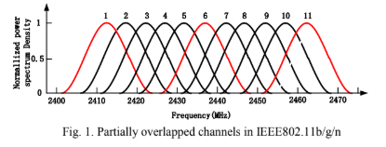
Channel Assignment Strategy
Partially vs No Overlapped Assignment
Channel Overlapping
there are 3 non-overlapped channels with IEEE 802.11b/g/n in 2.4 GHz band, while 12 non-overlapped channels with IEEE 802.11a in 5GHz band.

Slide 39
Channel Assignment Strategy
Partially Overlapped Assignment
Start
Min-interference and Connectivity-Oriented Partially Overlapped Channel Assignment (MC-POCA)
Calculate links assignment rank
Generate decreasing links queue
Utilize partially overlapped channels instead of 3 non-overlapped channels
Compute assuming interference
Routing Selection
End
Partially Overlapped Channel Assignment
P. Kyasanur and N.H. Vaidya, Routing and Link-layer Protocols for Multi-Channel Multi-Interface Ad Hoc Wireless Networks, SIGMOBILE Mobile Computing and Communications Review, vol. 10, no. 1, pp.

Slide 40
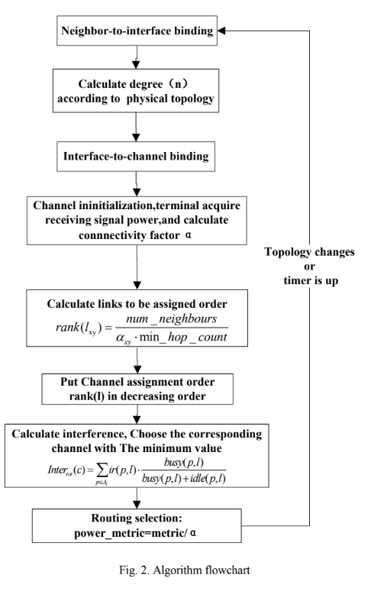
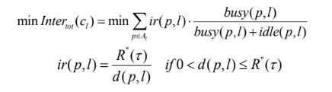

Channel Assignment Strategy
Min-interference and Connectivity-Oriented Partially Overlapped Channel Assignment (MC-POCA)
$$Rank\left(l\right) ∝ \frac{n_{neighbour}}{α_{xy}⋅min\left(hop_count\right)}$$
Connectivity factor
Interference range

Slide 41
Channel Assignment Strategy
Min-interference and Connectivity-Oriented Partially Overlapped Channel Assignment (MC-POCA)
1. Utilize partially overlapped channels instead of 3 non-overlapped channels
2. Still static and centralized
3. Require stable environments
P. Kyasanur and N.H. Vaidya, Routing and Link-layer Protocols for Multi-Channel Multi-Interface Ad Hoc Wireless Networks, SIGMOBILE Mobile Computing and Communications Review, vol. 10, no. 1, pp.

Slide 42
Evaluation Outline
Simulation
Graph Based Simulation
Random Graph
Grid Graph
NS-2 or NS-3
Deployment

Slide 43

Graph Based
Random Graph
$n$: Number of nodes
$L$: Square of dimension
$R:$ Radio Range
Ex:
$L=1000$ m and $R=250$ m
$n=25$, average degree is $3.8$
$n=50\text{, }\text{average} \text{degree} \text{is} 7.5$
$n=75\text{, }\text{average} \text{degree} \text{is} 11.5$
Ali, Husnain Mansoor & Busson, Anthony & Vèque, Véronique. (2009). Channel Assignment Algorithms: A Comparison of Graph Based Heuristics. 10.1145/1641913.1641931.

Slide 44
Graph Based
Grid Graph
Internal nodes with degree 4
Side nodes with degree 3
Corner nodes with degree 2

Slide 45

Network Simulator
NS-2 or NS-3
Discrete-event simulation
Research and education use
Realtime network emulate
Ability:
Incorporate existing real-world protocol implementations
Support real-time scheduler for interacting with real systems.
Reuse of real application and kernel code.
Notes:
A discrete-event simulation models the operation of a system as a sequence of events in time. Each event occurs at a particular instant in time and marks a change of state in the system.

Slide 46
Performance Metrics
Fractional Network Interference
Network Throughput

Slide 47




Fractional Network Interference
Graph based:
Communication graph:
Conflict graph (binary interference):
A
B
C
D
E
$$I_{AB}$$
$$I_{BC}$$
$$I_{CD}$$
$$I_{DE}$$

Slide 48

Fractional Network Interference
$FNI=\frac{I\left(f\right)}{\left|E\left(G_{c}\right)\right|}$
Binary interference:
$I\left(f\right)=\sum_{\left(u,v\right)∈M}{t\left(u\right)t\left(v\right)r\left(u,v\right)}$
$t\left(u\right)$: traffic of link $u$
$r\left(u,v\right)$: whether interference exist or not
Non-binary interference:
$I\left(f\right)=\sum_{\left(u,v\right)∈M}{t\left(u\right)t\left(v\right)r\left(u,v\right)}c\left(f\left(u\right),f\left(v\right)\right)$
$c\left(f\left(u\right),f\left(v\right)\right)$: interference factor between two channels

Slide 49
Network Throughput
Network Simulator based
Definition:
Measures how many data arrive in a unit time

Slide 50





PROJECT TIMELINE
Mesh Networks Channel Assignment Group
2020-4-30
Final
Prepare for the final presentation and submit the report. Celebrate!
ZhongZhen Chen
2020-3-20
Second milestone
2020-4-20
Implement and debug the method and simulate on random graph situations. Think of improvement possibilities of the method. Chang Liu
Fourth milestone
Discuss improvement possibility and write project report and think about what is learned in this project. Xiaoyan Li, Chang Liu
2020-3-4
First milestone
Read articles about related work and make decision of method for project question.
Xiaoyan Li
2020-4-5
Third milestone
Summarize experiment results and compare the results with existing methods. Analyze the reason of the performance difference. ZhongZheng Chen

Slide 51

References
Bahl, Paramvir, Ranveer Chandra, and John Dunagan. 2004. “SSCH.” Proceedings of the 10th Annual International Conference on Mobile Computing and Networking - MobiCom ’04. https://doi.org/10.1145/1023720.1023742.
Beheshtifard, Ziaeddin, and Mohammad Reza Meybodi. 2018. “An Adaptive Channel Assignment in Wireless Mesh Network: The Learning Automata Approach.” Computers & Electrical Engineering 72 (November): 79–91.
Bongsu, Raja Hasyifah Raja, Abdullah Mohammed, and Mohamad Afendee Mohamed. n.d. “Recent Trends in Channel Assignment Algorithms for Multi-Radio Multi-Channel in Wireless Mesh Network.” https://pdfs.semanticscholar.org/b6a6/810ecda50bcdbb9386d1f7f9a64006da3090.pdf.
Cheng, Hongju, Naixue Xiong, Athanasios V. Vasilakos, Laurence Tianruo Yang, Guolong Chen, and Xiaofang Zhuang. 2012. “Nodes Organization for Channel Assignment with Topology Preservation in Multi-Radio Wireless Mesh Networks.” Ad Hoc Networks. https://doi.org/10.1016/j.adhoc.2011.02.004.
Ding, Yong, Yi Huang, Guokai Zeng, and Li Xiao. 2008. “Channel Assignment with Partially Overlapping Channels in Wireless Mesh Networks.” In Proceedings of the 4th Annual International Conference on Wireless Internet, 38. ICST (Institute for Computer Sciences, Social-Informatics and Telecommunications Engineering

Slide 52
References
Duarte, P. B. F., Z. M. Fadlullah, A. V. Vasilakos, and N. Kato. 2012. “On the Partially Overlapped Channel Assignment on Wireless Mesh Network Backbone: A Game Theoretic Approach.” IEEE Journal on Selected Areas in Communications 30 (1): 119–27.
Du, P., W. Jia, L. Huang, and W. Lu. 2007. “Centralized Scheduling and Channel Assignment in Multi-Channel Single-Transceiver WiMax Mesh Network.” In 2007 IEEE Wireless Communications and Networking Conference, 1734–39.
Ko, B., V. Misra, J. Padhye, and D. Rubenstein. 2007. “Distributed Channel Assignment in Multi-Radio 802.11 Mesh Networks.” In 2007 IEEE Wireless Communications and Networking Conference, 3978–83. Liu, Y., R. Venkatesan, and C. Li. 2009. “Channel Assignment Exploiting Partially Overlapping Channels for Wireless Mesh Networks.” In GLOBECOM 2009 - 2009 IEEE Global Telecommunications Conference, 1–5.
Meng, X., K. Tan, and Q. Zhang. 2006. “Joint Routing and Channel Assignment in Multi-Radio Wireless Mesh Networks.” In 2006 IEEE International Conference on Communications, 8:3596–3601.
Mogaibel, Hassen A., Mohamed Othman, Shamala Subramaniam, and Nor Asilah Wati Abdul Hamid. 2016. “Review of Channel Assignment Approaches in Multi-Radio Multi-Channel Wireless Mesh Network.” Journal of Network and Computer Applications 72 (September): 113–39.

Slide 53
References
Raniwala, Ashish, Kartik Gopalan, and Tzi-Cker Chiueh. 2004. “Centralized Channel Assignment and Routing Algorithms for Multi-Channel Wireless Mesh Networks.” ACM SIGMOBILE Mobile Computing and Communications Review. https://doi.org/10.1145/997122.997130.
Raniwala, A., and Tzi-cker Chiueh. 2005. “Architecture and Algorithms for an IEEE 802.11-Based Multi-Channel Wireless Mesh Network.” In Proceedings IEEE 24th Annual Joint Conference of the IEEE Computer and Communications Societies., 3:2223–34 vol. 3.
Skalli, H., S. K. Das, L. Lenzini, and M. Conti. 2006. “Traffic and Interference Aware Channel Assignment for Multi-Radio Wireless Mesh Networks.” In Proc. of ACM Int. Conf. on Mobile Comput. and Netw (MOBICOM) Pp, 15–26.
Skalli, H., S. Ghosh, S. K. Das, L. Lenzini, and M. Conti. 2007. “Channel Assignment Strategies for Multiradio Wireless Mesh Networks: Issues and Solutions.” IEEE Communications Magazine 45 (11): 86–95.
Subramanian, A. P., H. Gupta, S. R. Das, and J. Cao. 2008. “Minimum Interference Channel Assignment in Multiradio Wireless Mesh Networks.” IEEE Transactions on Mobile Computing 7 (12): 1459–73.
Wang, J., B. Xie, K. Cai, and D. P. Agrawal. 2007. “Efficient Mesh Router Placement in Wireless Mesh Networks.” In 2007 IEEE International Conference on Mobile Adhoc and Sensor Systems, 1–9.

Slide 54
References
Yin, Z., Z. Li, and M. Chen. 2007. “A Novel Channel Assignment Algorithm for Multicast in Multi-Radio Wireless Mesh Networks.” In 2007 12th IEEE Symposium on Computers and Communications, 283–88.
Zhao, Xiongwen, Siyuan Zhang, Liang Li, Zhaoyan Qu, Yu Zhang, Yi Ding, and Junyu Liu. 2018. “A Multi-Radio Multi-Channel Assignment Algorithm Based on Topology Control and Link Interference Weight for a Power Distribution Wireless Mesh Network.” Wireless Personal Communications 99 (1): 555–66.
Kim, S.-H., Kim, D.-W., Suh, Y.-J., 2011. A cooperative channel assignment protocol for multi-channel multi-rate wireless mesh networks. Ad Hoc Netw. 9, 893–910.
Chiu, H.S., Yeung, K., Lui, K.-S., 2009. J-car: an efficient joint channel assignment and routing protocol for IEEE 802.11-based multi-channel multi-interface mobile ad hoc networks. IEEE Trans. Wirel. Commun. 8, 1706–1715.
Mogaibel, H.A., Othman, M., Subramaniam, S., Hamid, N.A.W.A., 2012. On-demand channel reservation scheme for common traffic in wireless mesh networks. J. Netw. Comput. Appl. 35, 132–151.
Chaudhry, A., Ahmad, N., Hafez, R., 2012. Improving throughput and fairness by improved channel assignment using topology control based on power control for multi-radio multi-channel wireless mesh networks. EURASIP J. Wirel. Commun. Netw. 2012, 1–25.
Draves, R., Padhye, J., Zill, B., 2004. Routing in multi-radio, multi-hop wireless mesh networks. In: Proceedings of the 10th Annual International Conference on Mobile Computing and Networking (MobiCom 04), ACM, New York, NY, USA, pp. 114–128.

Slide 55
References
M.K. Marina and S.R. Das and A.P. Subramanian, A topology control approach for utilizing multiple channels in multi-radio wireless mesh networks, Computer Networks, Elsevier, vol. 54, no. 2, pp. 241-256, 2010.
K. N. Ramachandran, E. M. Belding, K. C. Almeroth, and M. M. Buddhikot, Interference-Aware Channel Assignment in Multi-Radio Wireless Mesh Networks, Proceedings of 25th IEEE International Conference on Computer Communications, INFOCOM, pp. 1-12, 2006.
A. U. Chaudhry, R. H.M. Hafez, and J. W. Chinneck, Improving throughput and fairness by improved channel assignment using topology control based on power control for multi-radio multi-channel wireless mesh networks, EURASIP Journal on Wireless Communications and Networking, no. 1, pp. 1-25, 2012, Springer.
K. Xing, X. Cheng, L. Ma, and Q. Liang, Superimposed code based channel assignment in multi-radio multi-channel wireless mesh networks, Proceedings of the 13th annual ACM international conference on Mobile computing and networking, pp. 15-26, 2007.
J. Gummeson, D. Ganesan, M. D. Corner, and P. Shenoy, An Adaptive Link Layer for Range Diversity in Multi-radio Mobile Sensor Networks, In Proceedings IEEE INFOCOM, Conference on Computer Communications, pp. 154-162, 2009.

Slide 56
References
J. Wang, Z. Wang, Y. Xia, and H. Wang, A practical approach for channel assignment in multi-channel multi-radio wireless mesh networks, Fourth International Conference on Broadband Communications, Networks and Systems, BroadNets, pp. 317-319, September 2007.
P. Kyasanur and N.H. Vaidya, Routing and Link-layer Protocols for Multi-Channel Multi-Interface Ad Hoc Wireless Networks, SIGMOBILE Mobile Computing and Communications Review, vol. 10, no. 1, pp.311743, January 2006.
Y. Ding, K. Pongaliur, and L. Xiao, Channel allocation and routing in hybrid multichannel multiradio wireless mesh networks, IEEE Transactions on Mobile Computing, vol. 12, no. 2, pp. 206-218, 2013, IEEE.
K. Liu, N. Li and Y. Liu, "Min-interference and connectivity-oriented partially overlapped channel assignment for multi-radio multi-channel wireless mesh networks," 2017 3rd IEEE International Conference on Computer and Communications (ICCC), Chengdu, 2017, pp. 84-88.

Slide 57
Reference
Ali, Husnain Mansoor & Busson, Anthony & Vèque, Véronique. (2009). Channel Assignment Algorithms: A Comparison of Graph Based Heuristics. 10.1145/1641913.1641931.
A. P. Subramanian, H. Gupta and S. R. Das, "Minimum Interference Channel Assignment in Multi-Radio Wireless Mesh Networks," 2007 4th Annual IEEE Communications Society Conference on Sensor, Mesh and Ad Hoc Communications and Networks, San Diego, CA, 2007, pp. 481-490. doi: 10.1109/SAHCN.2007.4292860

